Slide 1

The Secret Sauce of Talking to AI: Effective Communication
Unlock the full potential of AI by learning to communicate effectively. This framework transforms vague requests into precise, actionable instructions, turning AI into a powerful collaborator.

Slide 2

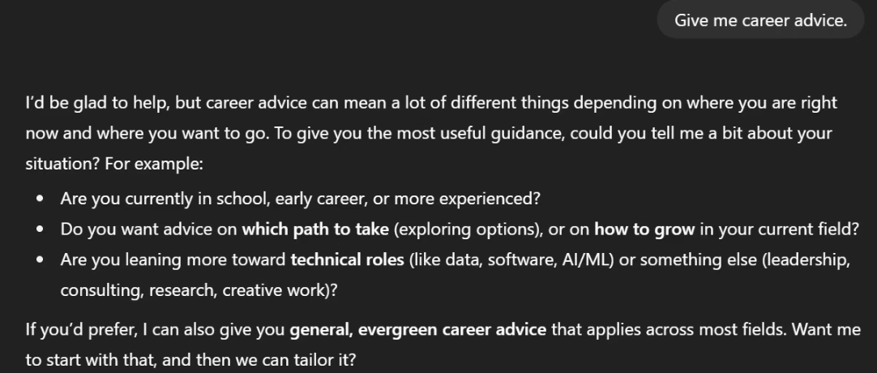
Why Most AI Interactions Fail
Many AI interactions fall short because our instructions are often too broad or lack crucial details. Without clear guidance, even the most advanced AI can't deliver the specific, useful results we need.
Vague Request Example
The Problem: Lack of Clarity
AI can't read minds. Broad requests lead to generic, unhelpful outputs, wasting time on back-and-forth clarifications.
"Give me career advice."
AI's response: Hesitant, asks clarifying questions. No concrete advice due to broad input.

Slide 3


The Power of a Detailed Prompt
Transform your AI interactions from frustrating to fruitful. Specific, well-structured prompts guide AI to deliver precise, valuable, and actionable results every time.
Detailed Request Example
The Solution: Clarity
By clearly defining the AI's persona, your specific situation, the desired output format, and key areas of focus, you empower the AI to generate highly relevant and useful information, eliminating guesswork and irrelevant suggestions.
"Act as a career counselor. Provide three actionable steps for a recent college graduate with a marketing degree looking for their first job in tech, specifically in a social media management role. Focus on networking strategies, resume optimization for Applicant Tracking Systems (ATS), and interview preparation for remote positions."
AI's response: "Here are three actionable steps for securing a social media management role in tech, including tailored advice on networking strategies, ATS-friendly resume tips, and remote interview preparation guidance."

Slide 4




The 4 C's Framework: Solution Overview
The 4 C's framework provides a structured approach to AI communication, ensuring clarity, precision, and purposeful instructions for optimal results.
Context
Constraints
Who are you, what's the situation?
Word count, deadlines, tone, tools.
Content Goal
Check
What output do you need?
Verify sources or structure.

Slide 5

C1: Context
Define your role and the situation. This helps AI understand your perspective and tailor its response appropriately.
"I'm a final-year computer science student interested in machine learning and data science."
Providing context transforms AI from a "question deflector" into a "career coach," delivering high-value, ready-to-use output.

Slide 6

C2: Constraints
Specify limitations like word count, deadlines, tone, or tools. This guides the AI to produce output that fits your exact requirements.
"Plan a 3-day trip to NYC for two in October with a $1,000 budget. Focus on affordable food, free attractions, and public transport."
Clear constraints turn AI into a personal travel agent, providing actionable, bookable plans tailored to your needs.

Slide 7

C3: Content Goal
Clearly state the specific outcome you want from the AI, whether it's a summary, a plan, or an essay. This prevents generic responses.
"Suggest a 4-week beginner-friendly home workout plan (30 mins, 3-4 times/week) focusing on strength and cardio with minimal equipment."
A well-defined content goal transforms AI from a "general advisor" into a "personal coach," delivering concrete, personalized action plans.

Slide 8

C4: Check
Instruct the AI to verify its own output, such as checking sources or ensuring structural integrity. This enhances reliability and accuracy.
"Before finalizing, check that your response matches the format & length, aligns with the goal, and clearly explains reasoning."
This step ensures the AI's output is reliable, safe, and useful, reducing errors and misunderstandings.

Slide 9


Case Study: Maya's Academic Assignment:
See how Maya transformed her assignment from an unsuccessful, vague prompt to a successful, structured request using the 4 C's.
Unsuccessful Attempt
Successful Transformation
"Write me something about AI in healthcare."
"I'm a grad student writing a 500-word literature review on AI in healthcare. Organize it with intro, 2-3 themes, conclusion. Academic tone, 3 real scholarly APA citations."
Generic, blog-style overview.
No citations, casual tone.
Structured draft with headings.
Wasted time, increased risk of failure.
Real citations, academic tone.
Submission-ready in minutes.

Slide 10
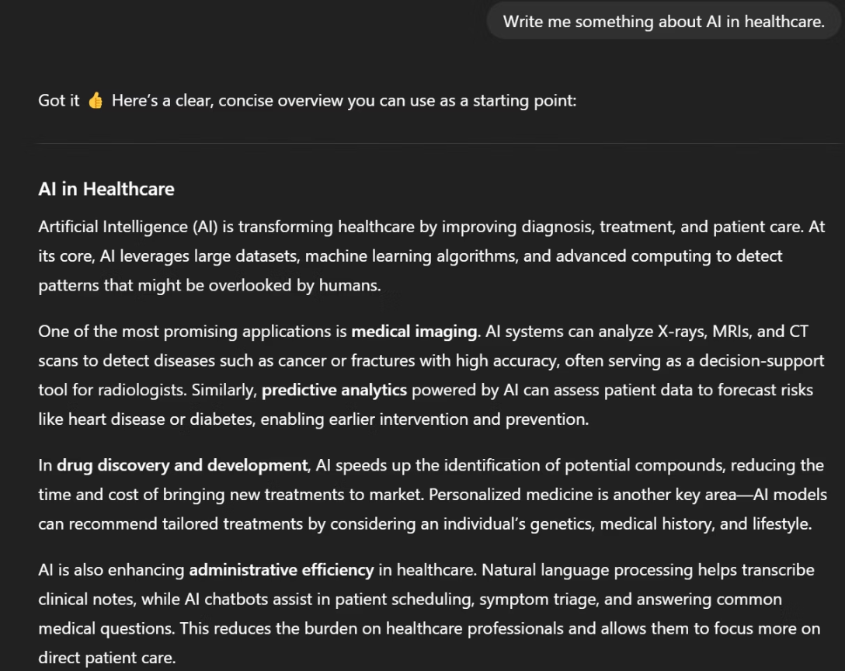
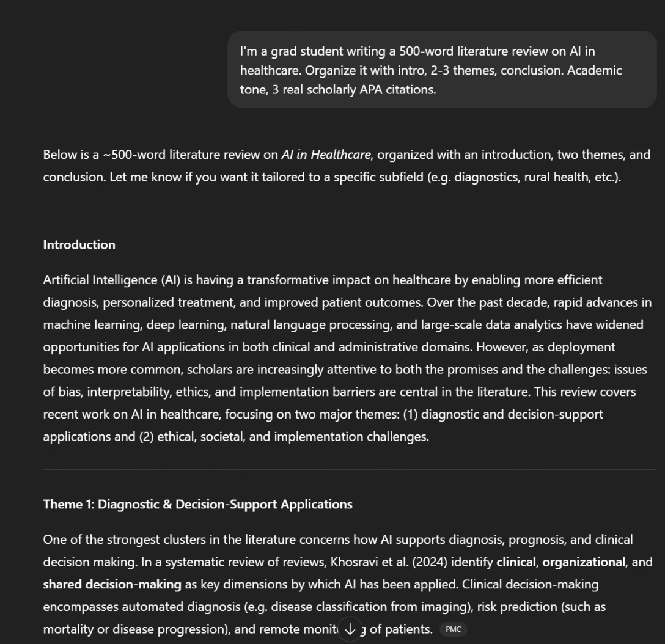
Case Study: Maya's Academic Assignment: Results
Unsuccessful Attempt
Successful Transformation
"Write me something about AI in healthcare."
Generic, blog-style overview.
No citations, casual tone.
"I'm a grad student writing a 500-word literature review on AI in healthcare. Organize it with intro, 2-3 themes, conclusion. Academic tone, 3 real scholarly APA citations."
Wasted time, increased risk of failure.
Structured draft with headings.
Real citations, academic tone.
Submission-ready in minutes.

Slide 11

Reusable Prompt Template
Apply this template to any AI task to ensure clear, effective communication and consistently high-quality results.
[ROLE/CONTEXT] You are [role/expertise of AI] helping a [who you are].
[GOAL] I need you to [specific outcome you want].
[CONSTRAINTS]
Length: [e.g., 500 words, 3 bullet points]
Format: [essay, table, code, checklist]
Style/Tone: [formal, academic, storytelling]
References/Data: [cite sources / use only my data]
[CONTENT DETAILS] Here’s the context/background you need:
[Key fact 1]
[Key fact 2]
[OUTPUT CHECK] Before finalizing, check that your response:
Matches the format & length.
Aligns with the goal.

Slide 12

Key Takeaways & Next Steps
Mastering AI communication is about being clear, simple, and intentional. The 4 C's framework empowers you to get reliable, professional-quality results every time.
Garbage In, Garbage Out
AI as Collaborator
Vague input leads to vague, unhelpful output. Precision is key.
With clear communication, AI becomes a powerful partner, not just a "guessing machine."
Practice the 4 C's
Consistently apply Context, Constraints, Content Goal, and Check for optimal results.

